Slide 1
Innovations to Watch in Community Solar
How Solar-Plus-Storage, Service Bundles and Community Partnerships Add Lasting Value for Community Solar
Jill K. Cliburn • jkcliburn@cliburnenergy.com

Slide 2
How We Got Here
Early, premium-priced community solar helped grow the solar market
Long-term savings came with virtual net metering
Financing innovations have promoted “savings from day one”
Community solar has worked better with a policy push
Our focus: creating partnerships to increase project value
…against a backdrop of rising renewable energy targets
…and concern for equity and inclusion
Community solar innovations can help grow
the solar market and protect long-term savings

Slide 3
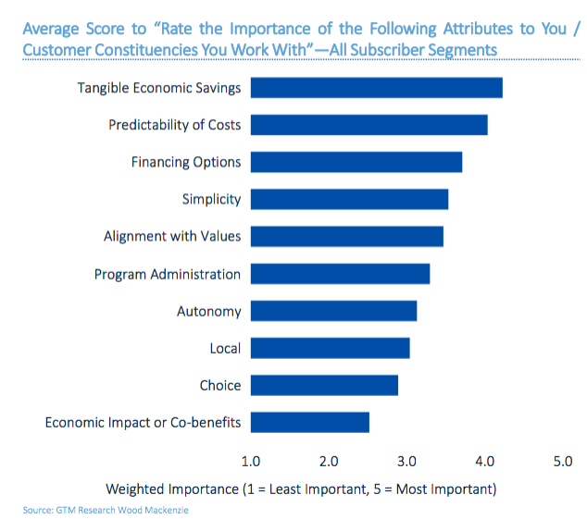
Community Solar Customers Want…
Economic savings
Predictability of costs
Financing options
Simplicity
Alignment w/ personal values
(Benefits Available to LMI)
Policy can support these, but market forces affect the long-term outlook for community solar.
Vote Solar 2018

Slide 4
Welcome to the Future
Developers assess the likely return for bankable projects (i.e., don’t worry). Yet, as renewables increase, the market value of new PV-only projects will slip.
Do falling solar costs and rising market shares affect future project participants’ realistic savings expectations?
What strategies can add flexibility and secure community solar value?

Slide 5
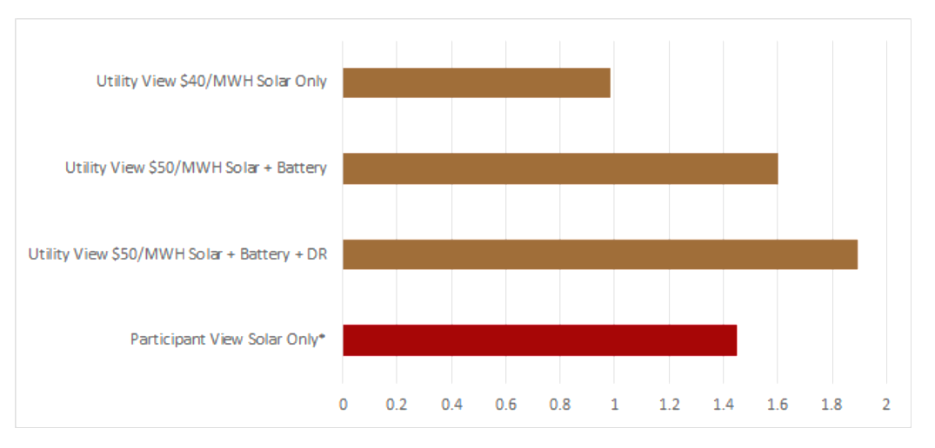
Sample Case: Solar+Storage or a Triple-Play
To Reduce Demand and Improve Net Benefits
Community solar plus a utility-side battery (1 MW / 2MWH) would reduce wholesale demand charges and increase B/C to about 1.6. This utility also had an ongoing DR program, so it tested load-management controls for an additional 200-kW demand reduction. Community solar subscribers benefit more or less, depending on program structure. (Cliburn, 2018)

Slide 6
Alternative Biz Models for
Community Solar-Plus
Utilities share storage benefits, e.g., demand reduction, with community solar participants (new rates, bill credits)
Developers receive an incentive per kWh on non-utility solar-plus projects
Adding storage may help gain interconnection approval / siting benefit
Community solar projects may be required to have storage (& perhaps other high-value design elements); participants share added benefits
Demand reduction (DR), energy efficiency (EE), weatherization or other companion measures boost bill savings—though implementation is hard
Savings measures may be subsidized through donations, grants, or other programs for LMI customers

Slide 7
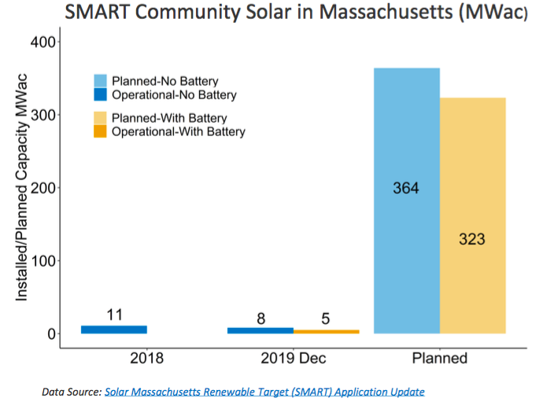
Examples - State Level
MA provides Energy Storage Adder credits for community solar-plus. Goals for 687 MW community solar; 325 MW with storage
NY has just announced 75 MW new community solar, including 15 MW paired with storage by 2025; more to come
NY examples include a CCA-type program on behalf of all electric customers in the town of Lima
Some state community solar rules allow solar-plus without providing details.

Slide 8
Examples - Local Utilities
Fayetteville, NC and Sterling, MA community solar plus utility storage
Roanoke NC EMC also offers community solar plus utility storage; grant funds support shares for LI, along with home weatherization
Orcas Power & Light, WA community solar-plus, including LMI donation; financing for efficiency add-on
Sacramento (SMUD) offers storage shares for demand-reduction benefits to commercial customers

Slide 9
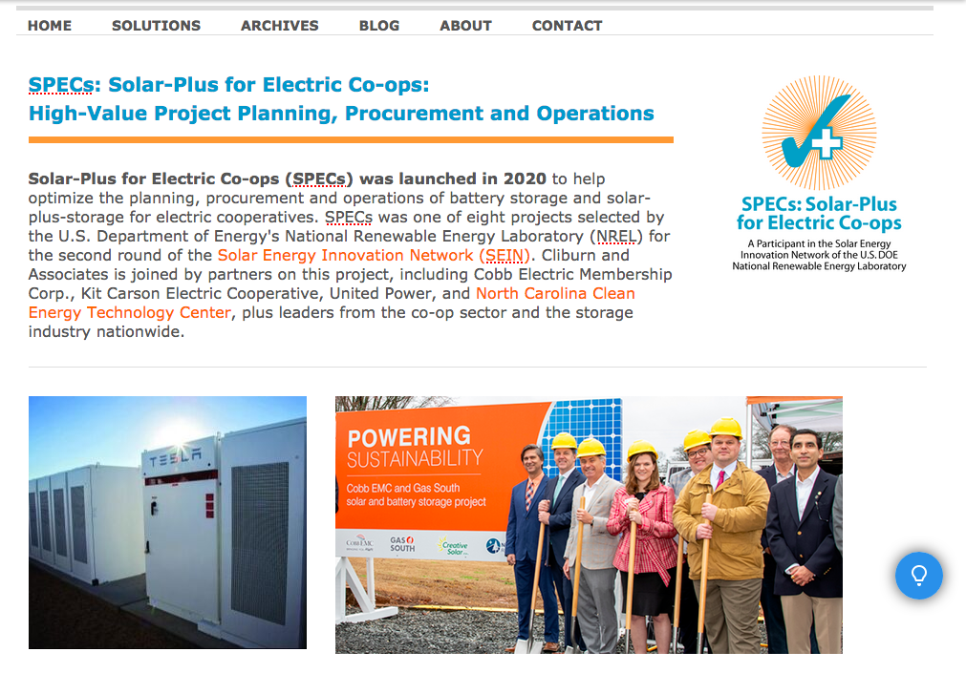
Watch for More from the SPECs Project
Cliburn and Assoc. has worked with NCCETC and the NREL Solar Energy Innovation Network
Education on what solar plus storage offers to the local community and upstream market players
A modeling tool that can help co-ops, munis and others to estimate solar-plus value
A framework for best-practices project procurement
www.solarvalueproject.com

